Slide 1


Fort Payne High School JROTC
“Wildcat Battalion”
Army JROTC
Awards and Ribbons
LTC Walker and SFC Maks

Slide 2
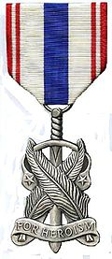
Fort Payne High School JROTC
“Wildcat Battalion”
Medal of Heroism
Awarded to JROTC cadets who distinguish themselves by acts of heroism performed on or off campus. Act must result in accomplishment so exceptional / outstanding as to set cadet apart from others in similar circumstances and must involve acceptance of danger or extraordinary responsibilities exemplifying praiseworthy fortitude and courage

Slide 3
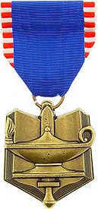
Fort Payne High School JROTC
“Wildcat Battalion”
50 Points: Military scholarship and grades (grades earned in JROTC or NDCC course)
50 Points: Academic scholarship and grades (grades earned in all courses other than JROTC or NDCC)
50 Points: Military leadership
50 Points: Academic Leadership (separate from academic grades attained in JROTC, NDCC, and regular courses. Includes all demonstrated qualities of leadership in student organizations, constructive activities, participation in sports, etc.)
100 Points: Demonstrated qualities of discipline, courtesy, and character, and consistently demonstrated potential qualities as an officer (to be an overall estimate for all pertinent elements of the Cadet’s performance)
Total possible points: 300
Superior Cadet Award
Awarded to 1 cadet in each LET level
1 year observation by board members.
Selection by board chaired by SAI
In top 10% of JROTC class
In top 50% of academic class
Nominations are forwarded to brigade NLT 45 days before end of school year.

Slide 4
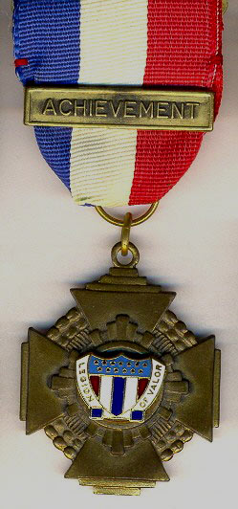
Fort Payne High School JROTC
“Wildcat Battalion”
50 Points: Military scholarship and grades (grades earned in JROTC or NDCC course)
50 Points: Academic scholarship and grades (grades earned in all courses other than JROTC or NDCC)
50 Points: Military leadership
50 Points: Academic Leadership (separate from academic grades attained in JROTC, NDCC, and regular courses. Includes all demonstrated qualities of leadership in student organizations, constructive activities, participation in sports, etc.)
100 Points: Demonstrated qualities of discipline, courtesy, and character, and consistently demonstrated potential qualities as an officer (to be an overall estimate for all pertinent elements of the Cadet’s performance)
Total possible points: 300
Legion of Valor Bronze
Cross for Achievement
Awarded to 1 outstanding junior cadet
1 year observation by board members.
Selection by board chaired by SAI
In top 10% of JROTC class
In top 50% of academic class
Nominations are forwarded to brigade NLT 45 days before end of school year.

Slide 5
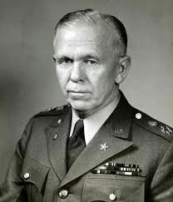
Fort Payne High School JROTC
“Wildcat Battalion”
Army JROTC
George C. Marshall
Award
Presented to cadets selected to attend the national level of the Army’s JROTC Leadership Symposium and Academic Bowl (JLAB) event.
Compete as a member of the team for Level I and Level II
Be in good academic and program standing at the time of the JLAB national level event.

Slide 6
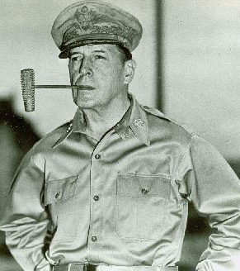
Fort Payne High School JROTC
“Wildcat Battalion”
Army JROTC
Mac Arthur Leadership
Award
Presented to cadets selected to attend the national level of the Army’s JROTC Leadership Symposium and Academic Bowl (JLAB) event.
Compete as a member of the team for Level I and Level II
Be in good academic and program standing at the time of the JLAB national level event.

Slide 7
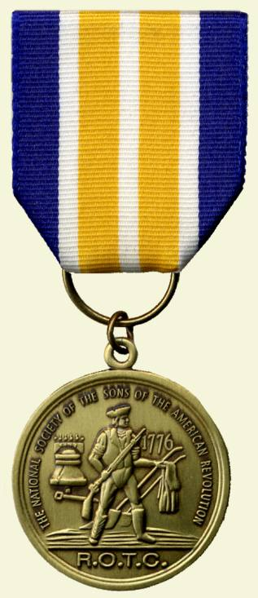
Fort Payne High School JROTC
“Wildcat Battalion”
Sons of the American Revolution
(SAR) Award
Presented to 1 outstanding junior cadet
Exhibit a high degree of merit with respect to leadership qualities, military bearing, all-around excellence in JROTC activities, and community service.
Be currently enrolled in JROTC
Be in the top 10% of their JROTC class
Be in the top 25% of their academic class

Slide 8
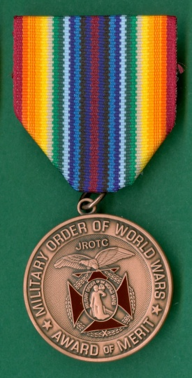
Fort Payne High School JROTC
“Wildcat Battalion”
Military Order of the World Wars Award
Presented to 1 cadet showing overall improvement in military and scholastic studies during the school year
Be in good standing in all military aspects and scholastic grades at the time of selection
Have shown marked improvement in both military and scholastic grades at the time of selection
Indicated a desire to serve his or her country
Participate in the program the following semester

Slide 9
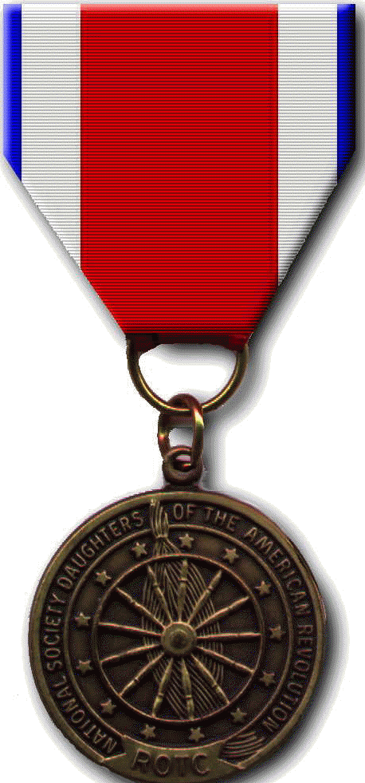
Fort Payne High School JROTC
“Wildcat Battalion”
Daughters of the American Revolution
(DAR) Award
Presented to 1 senior cadet for outstanding ability and achievement
Be a member of the graduating class
Be in the top 25% of their JROTC class
Be in the top 25% of their academic class
Have demonstrated qualities of dependability and good character, adherence to military discipline, leadership ability, and a fundamental and patriotic understanding of the importance of JROTC

Slide 10
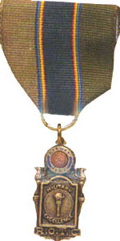
Fort Payne High School JROTC
“Wildcat Battalion”
American Legion
General Military Excellence Award
Presented to 1 outstanding cadet for general military excellence
Be in the top 25% of their JROTC class
Be in the top 25% of their academic class
Have demonstrated outstanding qualities in military leadership, discipline, character, and citizenship

Slide 11
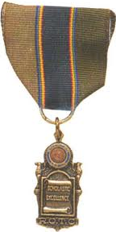
Fort Payne High School JROTC
“Wildcat Battalion”
American Legion
Scholastic Excellence Award
Presented to 1 outstanding cadet for scholastic excellence
Be in the top 10% of their academic
Be in the top 25% of their JROTC class
Have demonstrated qualities of leadership
Have actively participated in related student activities such as student organizations, constructive activities, or sports

Slide 12
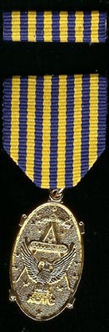
Fort Payne High School JROTC
“Wildcat Battalion”
National Sojourners Award
Presented to 1 outstanding cadet who contributed most to encourage and demonstrate Americanism within the Corps of Cadets and on campus
Be in the top 25% of their JROTC class
Be in the top 25% of their academic class
Have demonstrated outstanding qualities in military leadership, discipline, character, and citizenship

Slide 13
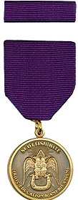
Fort Payne High School JROTC
“Wildcat Battalion”
Scottish Rite of Freemasonry
JROTC Award
Presented to 1 junior cadet who contributed most among cadets to encourage and demonstrate scholastic excellence and Americanism, by deeds or conduct during participation in integrated-curricular activities or community projects
Be in the top 25% of their academic class
Have demonstrated potential for outstanding leadership by exhibiting qualities of dependability, good citizenship, and patriotism

Slide 14
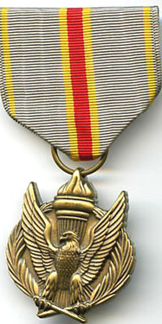
Fort Payne High School JROTC
“Wildcat Battalion”
US Army Recruiting Command
Award for JROTC
Presented to 1 outstanding junior cadet in recognition of outstanding achievement and contributions to JROTC
Be in the top 25% of their academic class
Have demonstrated outstanding leadership traits and possess the potential for assuming positions of increased responsibility
Participate in integrated-curricular activities that foster both scholastic and military excellence
Demonstrate qualities of dependability and good character, respect military discipline and standards, and possess a fundamental and patriotic understanding of the importance of JROTC training

Slide 15
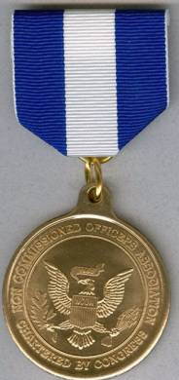
Fort Payne High School JROTC
“Wildcat Battalion”
Noncommissioned Officers
Association Award for JROTC
Presented to 1 outstanding cadet noncommissioned officer
NCO cadet must have consistently exhibited the best military bearing, personal appearance, deportment, and leadership ability in the unit
Selection by board of JROTC instructors

Slide 16
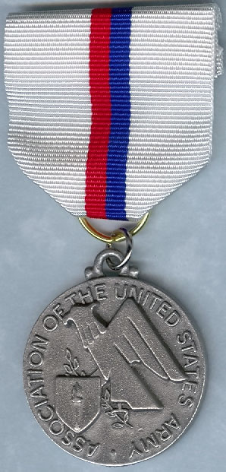
Fort Payne High School JROTC
“Wildcat Battalion”
Association of the United
States Army (AUSA) Medal
Presented to 1 cadet who is recognized for outstanding leadership and academic achievement

Slide 17
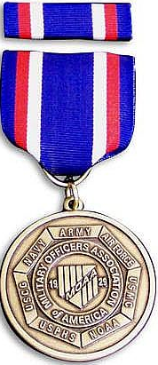
Fort Payne High School JROTC
“Wildcat Battalion”
Military Officers Association
of America (MOAA) JROTC medal
Presented to 1 junior cadet who demonstrated exceptional potential for military leadership.
Be in good academic standing
Demonstrate a high degree of loyalty to the unit, school, and the country

Slide 18
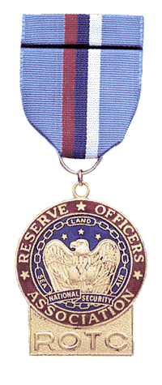
Fort Payne High School JROTC
“Wildcat Battalion”
Reserve Officers Association
(ROA) Award
Presented to 1 junior cadet in recognition of outstanding achievement and exceptional leadership ability
Be in good academic standing
Demonstrate a high degree of loyalty to their units, school, community, and country
Demonstrate exceptional potential in leadership

Slide 19
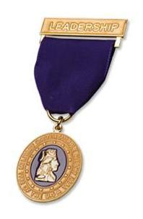
Fort Payne High School JROTC
“Wildcat Battalion”
Military Order of the Purple
Heart (MOPH) Award
Presented to 1 outstanding cadet who demonstrates leadership ability
Hold a positive attitude toward the JROTC and country
Hold a leadership position in the Corps of Cadets
Attain a grade of “B” or better in all subjects for the previous semester

Slide 20
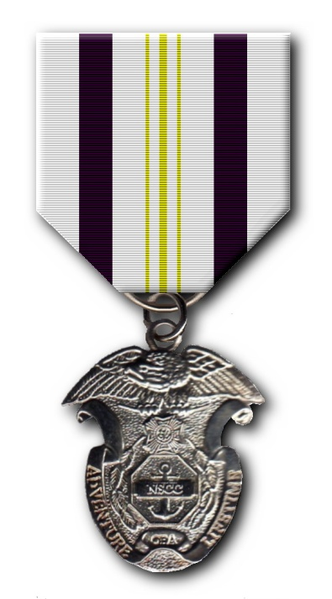
Fort Payne High School JROTC
“Wildcat Battalion”
Veterans of Foreign Wars
(VFW) Award
Presented to 1 cadet in 10th grade or above in recognition of outstanding achievement and exceptional leadership ability
Possess a positive attitude toward the JROTC
Have outstanding military bearing and conduct in and out of uniform
Demonstrate personal attributes of self-confidence, initiative, flexibility, and judgment
Show patriotism as commander or member of color guard, drill team with or without arms, flag protocol instruction team, and actively promote Americanism
Possess courtesy, dependability, punctuality, human relations, respect, and cooperation
Show growth potential and be capable of assuming high leadership responsibilities in the unit with additional training and experience

Slide 21
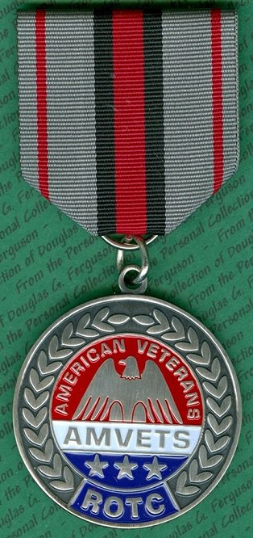
Fort Payne High School JROTC
“Wildcat Battalion”
American Veterans
(AMVETS) Medal
Presented to 1 junior cadet for outstanding leadership, community/school involvement and academic achievement
Be in good academic standing
Demonstrate a high degree of military bearing both in and out of the military uniform

Slide 22
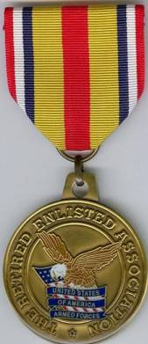
Fort Payne High School JROTC
“Wildcat Battalion”
The Retired Enlisted
Association (TREA) Award
Presented to 1 junior cadet who demonstrates exceptional potential in military leadership
Be in good academic standing
Present outstanding military bearing in and out of uniform
Demonstrate a high degree of loyalty to the unit, school, community, and the country.

Slide 23

Fort Payne High School JROTC
“Wildcat Battalion”
Daedalian JROTC
Achievement Award
Presented to 1 outstanding cadet who demonstrates patriotism, love of country, and service to our nation
Be in the top 10% of their JROTC class
Be in the top 20% of their academic class
Indicate the potential and desire to pursue a military career

Slide 24

Fort Payne High School JROTC
“Wildcat Battalion”
Celebrate Freedom Foundation/Embry-Riddle
Aeronautical University JROTC Award
Presented to 1 outstanding freshman or sophomore cadet
Be in the top 5% of their JROTC class
Be in the top 15% of their academic class
Must possess positive attitude and outstanding personal appearance
Display personal attributes of initiative, judgment, and self-confidence
Courteous demeanor (promptness, obedience, and respect for customs)
Growth potential (capacity for responsibility, high productivity, adaptability to change)
Indicate the potential and desire to pursue a military career

Slide 25
Fort Payne High School JROTC
“Wildcat Battalion”
The National Society, United States
Daughters of 1812 (USD 1812) Award
Presented to 1 senior or junior cadet who has demonstrated the qualities of academic excellence, leadership, military discipline, dependability, patriotism, and upright character in speech and habits, and which exemplifies the ideas upon which our nation was founded.
Be in good standing in all military aspects and scholastic grades
Exhibit a high degree of merit with respect to leadership qualities, military bearing, all-around excellence in JROTC activities, and community service
Have indicated by military and scholastic grades, integrated-curricular activities, or individual endeavor a desire to serve his or her country.

Slide 26
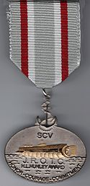
Fort Payne High School JROTC
“Wildcat Battalion”
Sons of Confederate Veterans
H. L. Hunley JROTC Award
Presented to 1 rising sophomore cadet who demonstrates the qualities of honor, courage, and commitment to his or her unit throughout the school year.
Be in good standing in academic and military grades

Slide 27

Fort Payne High School JROTC
“Wildcat Battalion”
Academic Ribbons
Distinguished Cadet
N-1-1
Academic Excellence
N-1-2
Academic Achievement
N-1-3
Awarded to 1 cadet who exhibits the highest degree of excellence in scholastics
Awarded to 1 cadet in each LET level for maintaining highest school academic grades
Awarded to those cadets who maintain a grade of “A” in JROTC and a “B” in remaining academic subjects
Perfect Attendance
N-1-4
Student Government
N-1-5
Leadership Development Service
N-1-6
Awarded to cadets with no unexcused absences during each semester
Awarded to cadets elected to a student government office
Awarded to cadets successfully completing first semester of training of each LET year
Academic Wreath

Slide 28
Fort Payne High School JROTC
“Wildcat Battalion”
Military Ribbons
SAI Leadership
N-3-1
Personal Appearance
N-3-2
Proficiency
N-3-3
Awarded to 1 cadet in each LET level who displays the highest degree of leadership
Awarded to cadets who consistently present an outstanding appearance
Awarded to cadets who demonstrate an exceptionally high degree of leadership, academic achievement, and performance of duty
Drill Team
N-3-4
Color Guard
N-3-6
Rifle Team
N-3-7
Awarded annually to qualified drill team members
Awarded annually to qualified color guard members
Awarded annually to qualified rifle team members
Adventure Training/Raiders Team
N-3-8
Commendation
N-3-9
Good Conduct
N-3-10
Awarded annually to qualified
raiders team members
Awarded to cadets whose performance of duty exceptionally exceeds that expected of cadets of their grade and experience
Awarded annually to cadets who have demonstrated outstanding conduct throughout the school

Slide 29
Fort Payne High School JROTC
“Wildcat Battalion”
Military Ribbons (cont.)
JCLC
N-3-11
Parking (SAI option)
N-3-13
Awarded to cadets for JCLC participation
Awarded to cadets who assist in parking at least two times per semester

Slide 30
Fort Payne High School JROTC
“Wildcat Battalion”
Athletic Ribbons
Varsity Athletics
N-2-1
JROTC Physical Fitness Award
N-2-2
JROTC Athletics
N-2-3
Awarded annually to cadets in varsity sports
Awarded annually to cadets who maintain excellent physical fitness and receive an 85% or better in all 5 Cadet Challenge events
Awarded annually to cadets who maintain a basic, yet challenging level of physical fitness and receive an 50% or better in all 5 Cadet Challenge events

Slide 31
Fort Payne High School JROTC
“Wildcat Battalion”
Miscellaneous Ribbons
Parade
N-4-1
Recruiting
N-4-2
School Support (SAI option)
N-4-3
Awarded to cadets who have participated in local community parades
Awarded to cadets who recruit students into the JROTC program each semester
Awarded to cadets for exceptionally meritorious performance of duty in
school support
Community Support (SAI option)
N-4-4
Service Learning
N-4-6
Excellent Staff Performance
N-4-7
Awarded to cadets for exceptionally meritorious performance of duty in community service
Awarded annually to cadets who participate in service learning projects
Awarded annually to cadet staff officers for excellent performance

Slide 32
Fort Payne High School JROTC
“Wildcat Battalion”

Slide 33
Fort Payne High School JROTC
“Wildcat Battalion”

